Slide 1
Process Overview

Slide 2
Development Stages
System conception. Conceive an application and formulate tentative requirements.
Analysis. Deeply understand the requirements by constructing models. The goal of analysis is to specify what needs to be done, not how it is done. You must understand a problem before attempting a solution.
System design. Devise a high-level strategy-the architecture-for solving the application problem. Establish policies to guide the subsequent class design.

Slide 3
Class design. Augment and adjust the real-world models from analysis.
Implementation. Translate the design into programming code and database structures.
Testing. Ensure that the application is suitable for actual use and that it truly satisfies the requirements. .
Training. Help users master the new application.
Deployment. Place the application in the field
Maintenance. Preserve the long-term viability of the application.

Slide 4
Development life cycle
An 00 approach to software development supports multiple life-cycle styles. You can use a waterfall approach performing the phases of analysis, design, and implementation in strict sequence for the entire system. However, we typically recommend an iterative development strategy.

Slide 5
System conception
Some ways to find new system concepts:
New functionality: Add functionality to an existing system.
Streamlining: Remove restrictions or generalize the way a system works.
Simplification: Let ordinary persons perform tasks previously assigned to specialists.
Automation: Automate manual processes.
Integration: Combine functionality from different systems.
Analogies: Look for analogies in other problem domains and see if they have useful ideas.
Globalization: Travel to other countries and observe their cultural and business practices.

Slide 6
Elaborating a Concept
Most systems start as vague ideas that need more substance.
A good system concept must answer the following questions.

Slide 7
Who is the application for?
It is to understand which persons and organizations are stakeholders of the new system. Two of the most important kinds of stakeholders are the financial sponsors and the end users.
The financial sponsors are important because they are paying for the new system. They expect the project to be on schedule and within budget.

Slide 8
The users are also stakeholders, but in another sense. The users will ultimately determine the success of the new system by an increase (or decrease) in their productivity or effectiveness.
In general, users will not consider new software unless they have a compelling interest - either personal or business

Slide 9
What problem it solves?
The size of the effort must be clearly bounded and its scope must be established.
It must be determined that which features will be in the new system and which will not.
Various kinds of users in different organizations with their own viewpoints and political motivations must be reached.
It must not only be decided that which features are appropriate, but also must also the agreement of influential persons must be obtained.

Slide 10
Where will it be used?
At this early stage, it is helpful to get a general idea of where the new system might be used.
It should be determined that if the new system is mission-critical software for the organization, experimental software, or a new capability that can be deployed without disrupting the workflow.
A rough idea about how the new system will complement the existing systems is also essential.

Slide 11
When is it needed?
Two aspects of time are important.
Feasible time: It is the time in which the system can be developed within the constraints of cost and available resources.
Required time: It specifies when the system is needed to meet business goals.

Slide 12
Why is it needed?
A business case for the new system may need to be prepared if someone has not already done so. The business case contains the financial justification for the new system, including the cost, tangible benefits, intangible benefits, risk, and alternatives.
Motivation for the new system must be clearly understood.

Slide 13
How will it work?
Developers must always brainstorm about the feasibility of the problem. For large systems, merits of different architectures must be considered.
The purpose of this speculation is not to choose a solution, but to increase confidence that the problem can be solved reasonably.

Slide 14
The ATM Case Study
Original system concept for an Automated Teller Machine(ATM) is given below
Develop software so that customers can access a bank's computers and carry out their own financial transactions without the mediation of a bank employee.
Ask high-level questions to elaborate the initial concept
Questions to be asked

Slide 15
Preparing a Problem Statement
Once you have fleshed out the raw idea by answering the high-level questions, you are ready to write a requirements statement that outlines the goals and general approach of the desired system.

Slide 16
Kinds of Requirements
Requirements Statement . Problem scope . What is needed . Application context . Assumptions . Performance needs
Design . General approach . Algorithms . Data structures . Architecture . Optimizations . Capacity planning
Implementation . Platforms . Hardware specs . Software libraries . Interface standards
the problem statement should state what is to be done and not how it is to be implemented.
It should be a statement of needs, not a proposal for a system architecture.

Slide 17
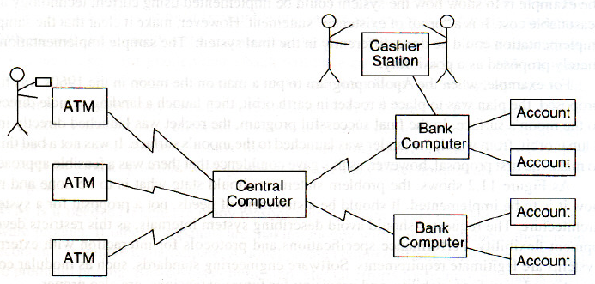
The ATM Case Study
Problem statement for an automated teller machine(ATM)network.

Slide 18
Domain Analysis
Domain analysis, the next stage of development, is concerned with devising a precise, concise, understandable, and correct model of the real world.
Before building anything complex, the builder must understand the requirements.
To build a domain model, you must interview business experts, examine requirements statements, and scrutinize related artifacts.

Slide 19
In this chapter you will learn how to take 00 concepts and apply them to construct a domain model.
The model serves several purposes: It clarifies the requirements, it provides a basis for agreement between the stake holders and the developers, and it becomes the starting point for design and implementation.

Slide 20
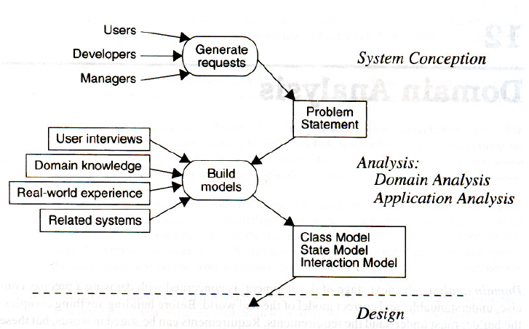
Overview of Analysis

Slide 21
We have divided analysis into two sub stages.
The first, domain analysis, is covered in this chapter and focuses on understanding the real-world essence of a problem.
The second, application analysis, is covered in the next chapter and builds on the domain model.

Slide 22
Domain Class Model
The first step in analyzing the requirements is to construct a domain model.
The domain model shows the static structure of the real-world system and organizes it into workable pieces.
The domain model describes real-world classes and their relationships to each other.

Slide 23
During analysis, the class model precedes the state and interaction models because static structure tends to be better defined, less dependent on application details, and more stable as the solution evolves.
Find classes and associations first, as they provide the overall structure and approach to the problem.
Next add attributes to describe the basic network of classes and associations.
Then combine and organize classes using inheritance.

Slide 24
An initial analysis model is likely to contain flaws that must be corrected by later iterations.
You must perform the following steps to construct a domain class model.
Find classes. Prepare a data dictionary. Find associations. Find attributes of objects and links. Organize and simplify classes using inheritance | Verify that access paths exist for likely queries. Iterate and refine the model. Reconsider the level of abstraction. Group classes into packages.

Slide 25
Finding Classes
The first step in constructing a class model is to find relevant classes for objects from the application domain.
Objects include physical entities, such as houses, persons, and machines , as well as concepts, such as trajectories, seating assignments, and payment schedules.
All classes must make sense in the application domain; avoid computer implementation constructs , such as linked lists and subroutines

Slide 26
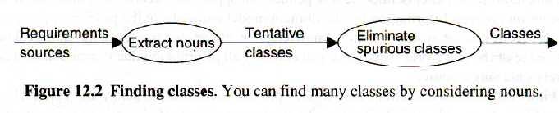

Slide 27
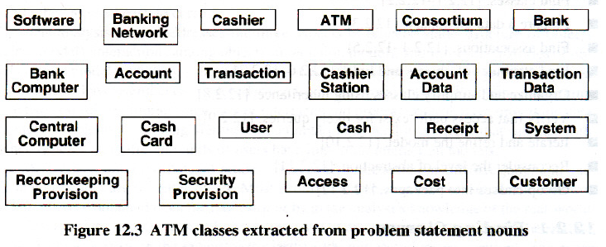
ATM example.
Examination of the concepts in the ATM problem statement from previous chapter yields the tentative classes shown below

Slide 28
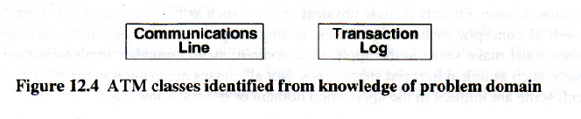
shows additional classes that do not appear directly in the statement but can be identified from our knowledge of the problem domain.

Slide 29
Keeping the Right Classes
Now discard unnecessary and incorrect classes according to the following criteria.

Slide 30
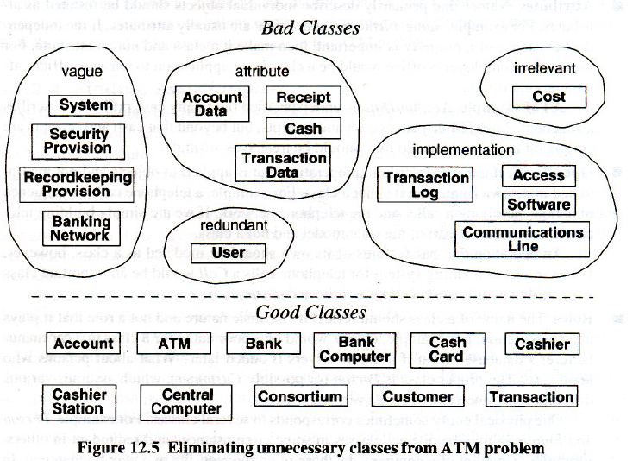

Slide 31
Redundant classes.
If two classes express the same concept, you should keep the most descriptive name. For example, Customer and User are redundant; we retain Customer because it is more descriptive.
Irrelevant classes.
If a class has little or nothing to do with the problem, eliminate it.

Slide 32
Vague classes.
A class should be specific. Some tentative classes may have ill-defined boundaries or be too broad in scope.
For example: Recordkeeping Provision is vague and is handled by Transaction. In other applications, this might be included in other classes, such as StockSales , Telephone Calls, or MachineFailures.

Slide 33
Attributes.
Names that primarily describe individual objects should be restated as attributes.
ATM example. Account Data is underspecified but in any case probably describes an account. An ATM dispenses cash and receipts, but beyond that cash and receipts are peripheral to the problem, so they should be treated as attributes

Slide 34
Operations
If a name describes an operation that is applied to objects and not manipulated in its own right, then it is not a class.
For example, in a billing system for telephone calls a Call would be an important class with attributes such as date, time, origin, and destination.

Slide 35
Roles
The name of a class should reflect its intrinsic nature and not a role that it plays in an association.
Implementation constructs
Eliminate constructs from the analysis model that are extraneous to the real world. You may need them later during design, but not now.
For example, CPU, subroutine, process, algorithm, and interrupt are implementation constructs for most applications, although they are legitimate classes for an operating system.

Slide 36
Derived classes.
As a general rule, omit classes that can be derived from other classes.
If a derived class is especially important, you can include it, but do so only sparingly.
Mark alI derived classes with a preceding slash ('I') in the class name.

Slide 37
Preparing a Data Dictionary
Isolated words have too many interpretations, so prepare a data dictionary for all modeling elements.
Write a paragraph precisely describing each class.
Describe the scope of the class within the current problem, including any assumptions or restrictions on its use.
The data dictionary also describes associations, attributes, operations, and enumeration values.

Slide 38
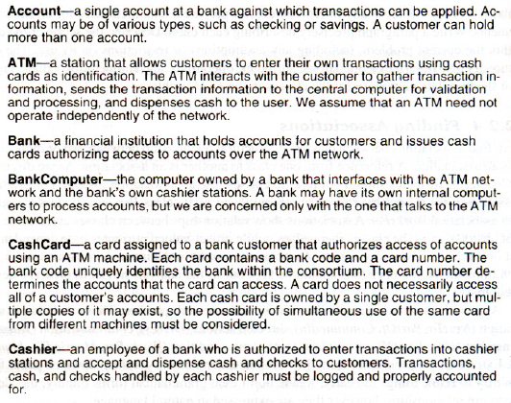

Slide 39
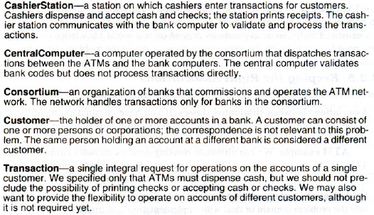

Slide 40
Finding Associations
Next, find associations between classes.
A structural relationship between two or more classes is an association.
The majority are taken directly from verb phrases in the problem statement.
For some associations the verb phrase is implicit in the statement.

Slide 41
Finally, some associations depend on real-world knowledge or assumptions.
These must be verified with the requestor, as they are not in the problem statement.

Slide 42
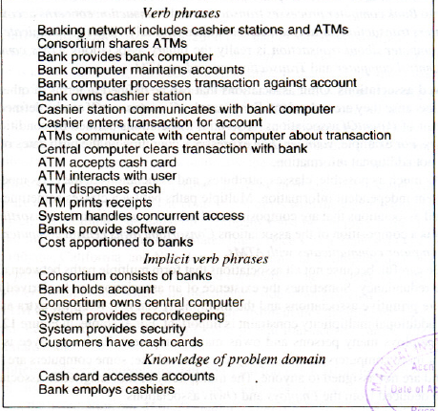

Slide 43
Keeping the Right Associations
Now discard unnecessary and incorrect associations, using the following criteria.
Associations between eliminated classes.
If you have eliminated one of the classes in the association, you must eliminate the association or restate it in terms of other classes.

Slide 44
ATM example. We can eliminate Banking network includes cashier stations and ATMs, ATM dispenses cash, ATM prints receipts, Banks provide software, Cost apportioned to banks, System provides recordkeeping, and System provides security.
Irrelevant or implementation associations.
Eliminate any associations that are outside the problem domain or deal with implementation constructs.

Slide 45
3. Actions.
An association should describe a structural property of the application domain, not a transient event.
Sometimes, a requirement expressed as an action implies an underlying structural relationship and you should rephrase it accordingly.
ATM accepts cash card describes part of the interaction cycle between an ATM and a customer, not a permanent relationship between ATMs and cash cards.

Slide 46
4. Ternary associations.
You can decompose most associations among three or more classes into binary associations If a term in a ternary association is purely descriptive and has no identity of its own, then the term is an attribute on a binary association.
Bank computer processes transaction against account can be broken into Bank computer processes transaction and Transaction concerns account.

Slide 47
5. Derived associations.
Omit associations that can be defined in terms of other associations, because they are redundant.
Consortium shares ATMs is a composition of the associations Consortium owns central computer and Central computer communicates with ATMs.

Slide 48
6.Association end names.
Add association end names where appropriate.
7. Qualified associations.
Usually a name identifies an object within some context; most names are not globally unique. The context combines with the name to uniquely identify the object. For example, the name of a company must be unique within the chartering state but may be duplicated in other states.

Slide 49
7.Multiplicity.
Specify multiplicity, but don't put too much effort into getting it right, as multiplicity often changes during analysis.
8.

Slide 50
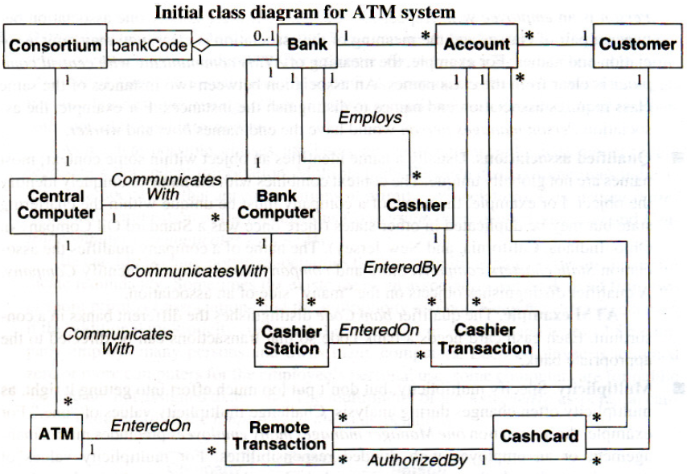

Slide 51
Finding Attributes and Keeping the Right Attributes
Attributes usually correspond to nouns followed by possessive phrases, such as "the color of the car" or "the position of the cursor."
Attributes are less likely to be fully described in the problem statement.
They must be derived based on knowledge in the application domain and the real world.

Slide 52
During analysis, attributes that are solely for implementation must be avoided. Each attribute is surely given a meaningful name.
Normally, derived attributes should be avoided. E.g. age is derived from birthdate and.
Derived attributes should not be expressed as operations, such as getAge, although they may be eventually implemented that way.

Slide 53
Attributes on associations must be looked for. Such an attribute is a property of the link between two objects, rather than being a property of an individual object.
E.g. the many-to-many association between Stockholder and Company has an attribute of numberOfShares.

Slide 54
Keeping the Right Attributes
Unnecessary and incorrect attributes are eliminated with the following criteria.
Objects: If the independent existence of an element is important, rather than just its value, then it is an object. E.g. boss refers to a class and salary is an attribute. The distinction often depends on the application. E.g. in a mailing list city might be considered as an attribute, while in a census City would be a class with many attributes and relationships of its own

Slide 55
Qualifiers: If the value of an attribute depends on a particular context, then the attribute can be considered to be restated as a qualifier. E.g. employeeNumber is not a unique property of a person with two jobs; it qualifies the association.

Slide 56
Identifiers:
An attribute whose only purpose is to identify an object should not be included as object identifiers are implicit in class models. Only the attributes that exist in the application domain are listed.
E.g. accountCode is a genuine attribute; Banks assign accountCodes and customers see them. In contrast, an internal transactionID should not be listed as an attribute, although it may be convenient to generate one during implementation.

Slide 57
Attributes on associations: If a value requires the presence of a link, then the property is an attribute of the association and not of a related class.
E.g. in an association between Person and Club the attribute membershipDate belongs to the association, because a person can belong to many clubs and a club can have many members.

Slide 58
Internal values: If an attribute describes the internal state of an object that is invisible outside the object, then it is eliminated from the analysis.
Fine detail: Minor attributes that are unlikely to affect most operations are omitted.
Boolean attributes: All Boolean attributes must be reconsidered. Often a Boolean attribute can be broadened and restated as an enumeration

Slide 60
Refining with Inheritance
The next step is to organize classes by using inheritance to share common structure. Inheritance can be added in two directions:

Slide 61
By generalizing common aspects of existing classes into a super-class (bottom up generalization)
Inheritance can be discovered from the bottom up by searching for classes with similar attributes, associations, and operations. For each generalization, a super-class is defined to share common features. Some attributes or classes have to be slightly redefined to fit in

Slide 62
By specializing existing classes into multiple subclasses (top down specialization)
They are often apparent from the application domain. Noun phrases composed of various adjectives on the class name must be looked for.: fluorescent lamp, incandescent lamp; fIxed menu, pop-up menu, sliding menu.

Slide 63
Generalization vs. enumeration: Enumerated sub-cases in the application domain are the most frequent source of specializations. Often, it is sufficient to note that a set of enumerated sub-cases exists, without actually listing them. E.g. an ATM account could be refined into CheckingAccount and SavingsAccount.
Multiple inheritance: It can be used to increase sharing, but only if necessary, because it increases both conceptual and implementation complexity.

Slide 64
Similar associations: When the same association name appears more than once with substantially the same meaning, the associated classes may be generalized.
ATM example: Transaction is entered on both CashierStation andATM; EntryStation generalizes CashierStation and ATM.

Slide 66
Iterating a class model:
A class model is rarely correct after a single pass. The entire software development process is one of continual iteration; different parts of a model are often at different stages of completion. If there is a deficiency, an earlier stage must be revisited if necessary to correct it. Some refinements can come only after completing the state and interaction models.

Slide 67
Shifting the Level of Abstraction
Sometimes the level of abstraction must be raised to solve a problem.
This is done throughout building a model, but make sure that abstraction is not overlooked.

Slide 68
E.g. One application is encountered in which the developers had separate classes for Individual Contributor, Supervisor, and Manager. Individual Contributors report to Supervisors and Supervisors report to Managers. This model certainly is correct, but it suffers from some problems. There is much commonality between the three classes-the only difference is the reporting hierarchy. E.g. they all have phone numbers and addresses.
The commonality is handled with a super-class, but that only makes the model larger. An additional problem arose when talked to the developers and they said they wanted to add another class for the persons to whom managers reported.

Slide 69
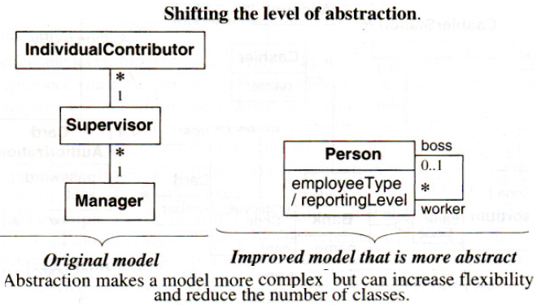

Slide 70
Figure shows the original model and an improved model that is more abstract. Instead of "hard coding" the management hierarchy in the model, "soft code" it with an association between boss and worker. A person who has an employee Type of "individualContributor" is a worker who reports to another person with an employeeType of "supervisor."

Slide 71
Grouping Classes into Packages
The last step of class modeling is to group classes into packages. A package is a group of elements (classes, associations, generalizations, and lesser packages) with a common theme.

Slide 72
Steps in constructing a domain state model:
Identify domain classes with states.
Find states.
Find events.
Build state diagrams.
Evaluate state diagrams.

Slide 73
List of domain classes are examined for those that have a distinct life cycle. Classes that can be characterized by a progressive history or that exhibit cyclic behavior must be identified.
The significant states in the life cycle of an object are identified. E.g. a scientific paper for a journal goes from Being written to Under consideration to Accepted or Rejected. There can be some cycles, for example, if the reviewers ask for revisions, but basically the life of this object is progressive.

Slide 74
On the other hand, an airplane owned by an airline cycles through the states of Maintenance, Loading, Flying, and Unloading. Not every state occurs in every cycle, and there are probably other states, but the life of this object is cyclic.

Slide 75
Finding States:
For each class, states are listed. In each class, objects are characterized - the attribute values that an object may have, the associations that it may participate in and their multiplicities, attributes and associations that are meaningful only in certain states, and so on.
Fine distinctions among states need not be focused, particularly quantitative differences, such as small, medium, or large. States should be based on qualitative differences in behavior, attributes, or associations

Slide 76
Finding Events:
Once the preliminary set of states is obtained, the events that cause transitions among states are found. The stimuli that cause a state to change be considered.
In many cases, an event can be regarded as completing a do-activity. E.g. if a technical paper is in the state Under consideration, then the state terminates when a decision on the paper is reached.
In this case, the decision can be positive (Accept paper) or negative (Reject paper). In cases of completing a do-activity, other possibilities are often possible and may be added in the future – e.g. Conditionally accept with revisions.

Slide 77
Other events can be identified by thinking about taking the object into a specific state. E.g. if the receiver on a telephone is lifted, it enters the Dialing state

Slide 78
Building State Diagrams
The states to which each event apply is noted. Transitions are added to show the change in state caused by the occurrence of an event when an object is in a particular state. If an event terminates a state, it will usually have a single transition from that state to another state

Slide 79
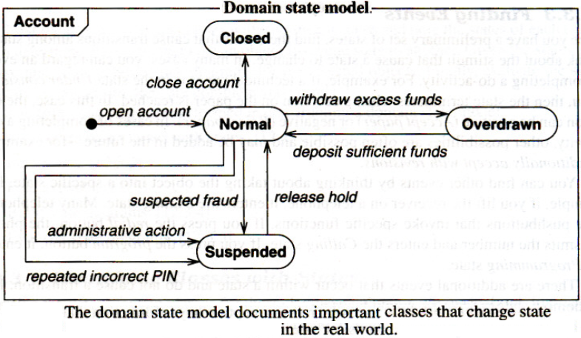

Slide 80
Evaluating State Diagrams
Each state model is examined. Are all the states connected? Paths through it are paid much attention.
If it represents a progressive class, is there a path from the initial state to the final state? Are the expected variations present?
If it represents a cyclic class, is the main loop present? Are there any dead states that terminate the cycle?

Slide 81
Domain Interaction Model
The interaction model is seldom important for domain analysis. During domain analysis the emphasis is on key concepts and deep structural relationships and not the users' view of them. The interaction model, however, is an important aspect of application modeling.

Slide 82
Iterating the Analysis
Most analysis models require more than one pass to complete.
Problem statements often contain circularities, and most applications cannot be approached in a completely linear way, because different parts of the problem interact.
To understand a problem with all its implications, the analysis is attacked iteratively - preparing a first approximation to the model and then iterating the analysis as understanding increases

Slide 83
Refining the Analysis Model
The overall analysis model may show inconsistencies and imbalances within and across models. Different portions are iterated to produce a cleaner, more coherent model.
Some constructs will feel awkward and won't seem to fit in right. They must be reexamined carefully; there may be wrong concepts
Classes or associations that seemed useful at first but now appear extraneous must be removed. Often two classes in the analysis can be combined, because the distinction between them doesn't affect the rest of the model in any meaningful way.

Slide 84
A good model feels right and does not appear to have extraneous detail. One need not worry if it doesn't seem perfect; even a good model will often have a few small areas where the design is adequate but never feels quite right.

Slide 85
Domain model: Description of the real-world objects reflected within the system. E.g. Domain objects for a stockbroker application might include stock, bond, trade, and commission.
Application model: Description of the parts of the application system itself that are visible to the user. E.g. Application objects might control the execution of trades and present the results.

Slide 86
Application Analysis
Steps to construct an application interaction model:
Determine the system boundary.
Find actors.
Find use cases.
Find initial and final events.
Prepare normal scenarios.
Add variation and exception scenarios.
Find external events.
Prepare activity diagrams for complex use cases.
Organize actors and use cases.
Check against the domain class model

Slide 87
Determining the System Boundary
System boundary is the precise scope of an application and its functionality. It decides what the system includes and, more importantly, what it omits.
If the system boundary is drawn correctly, the system can be treated as a black box in its interactions with the outside world i.e. the system can be considered as a single object, whose internal details are hidden and changeable

Slide 88
ATM E.g. Consider the software design to support a computerized banking network including both human cashiers and automatic teller machines [ATM]. From the customer's perspective either method of conducting business should yield the same effect on a bank account. However, in commercial practice an ATM application would be separate from a cashier application-an ATM application spans banks while a cashier application is internal to a bank. Both applications would share the same underlying domain model, but each would have its own distinct application model.

Slide 89
Finding Actors
Actors are the external objects that interact directly with the system. Actors include humans, external devices, and other software systems.
The important thing about actors is that they are not under control of the application, and are somewhat unpredictable.
That is, even though there may be an expected sequence of behavior by the actors, an application's design should be robust so that it does not crash if an actor fails to behave as expected.

Slide 90
For the ATM application, the actors are Customer, Bank, and Consortium.
Finding Use Cases
Each actor may use the system in different ways. Such fundamentally different ways for each actor is listed.
Each of these ways is a use case. The use cases partition the functionality of a system into a small number of discrete units, and all system behavior must fall under some use case

Slide 91
ATM E.g. if one use case in a bank is "apply for loan," then another use case should not be "withdraw cash from savings account using ATM." The latter description is much more detailed than the former; a better match would be "make withdrawal." Try to focus on the main goal of the use case and defer implementation choices.

Slide 92
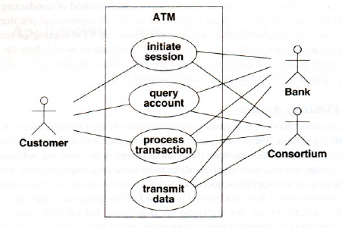

Slide 93
Finding Initial and Final Events:
Events that initiate each use case must be identified. Actor initiating the use case must be determined and the event that it sends' to the system is defined.
In many cases, the initial event is a request for the service that the use case provides.
In other cases, the initial event is an occurrence that triggers a chain of activity.
A meaningful name is given to such an event.
One need not determine its exact parameter list at this point.

Slide 94
The final event/s of to be included in each use case must also be determined i.e. deciding what are the final events and how much of them be included.
ATM example: Here are initial and final events for each use case.
Initiate session. The initial event is the customer's insertion of a cash card. There are two final events: the system keeps the cash card or the system returns the cash card.

Slide 95
Query account. The initial event is a customer's request for account data. The final event is the system's delivery of account data to the customer.
Process transaction. The initial event is the customer's initiation of a transaction. There are two final events: committing or aborting the transaction.
Transmit data. The initial event could be triggered by a customer's request for account data. Another possible initial event could be recovery from a network, power, or another kind of failure. The final event is successful transmission of data.

Slide 96
Preparing Normal Scenarios
It means preparing one or more typical dialogs for each use case to get a feel for expected system behavior. These scenarios illustrate the major interactions, external display formats, and information exchanges.
A scenario is a sequence of events among a set of interacting objects. One must think in terms of sample interactions, rather than trying to write down the general case directly. This helps to ensure that important steps are not overlooked and that the overall flow of interaction is smooth and correct.

Slide 97
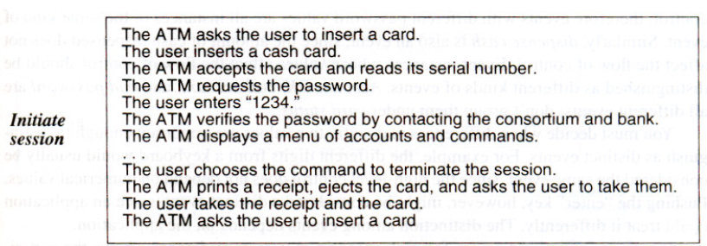
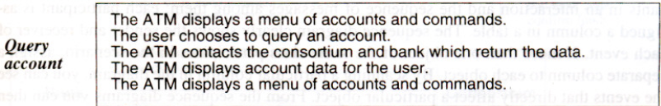

Slide 98
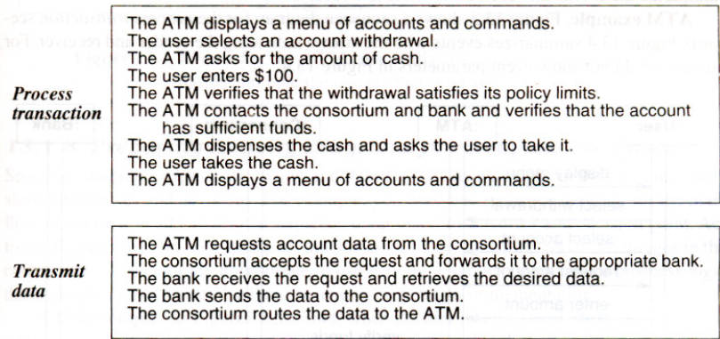

Slide 99
Adding Variation and Exception Scenarios
"Special" cases - such as omitted input maximum and minimum values, and repeated values are considered after typical scenarios are prepared.
Then error cases, including invalid values and failures to respond, are considered. For many interactive applications, error handling is the most difficult part of development. Better allow the user to abort an operation or roll back to a well-defined starting point at each step, if possible.

Slide 100
ATM example: Some variations and exceptions follow.
The ATM can't read the card.
The card has expired.
The ATM times out waiting for a response.
The amount is invalid.
The machine is out of cash or paper.
The communication lines are down.
The transaction is rejected because of suspicious patterns of card usage

Slide 101
Finding External Events
Scenarios are examined to find all external events - include all inputs, decisions, interrupts, and interactions to or from users or external devices.
An event can trigger effects for a target object.
Internal computation steps are not events, except for computations that interact with the external world.

Slide 102
A transmittal of information to an object is an event. E.g. enter password is a message sent from external agent User to application object ATM. Some information flows are implicit. Many events have parameters.
A sequence diagram is prepared for each scenario. A sequence diagram shows the participants in an interaction and the sequence of messages among them; each participant is assigned a column in a table.

Slide 103
The sequence diagram clearly shows the sender and receiver of each event.
If more than one object of the same class participates in the scenario, a separate column is assigned to each object.
By scanning a particular column in the diagram, one can see the events that directly affect a particular object.
Events that each class sends and receives can be then summarized from the sequence diagrams.

Slide 104
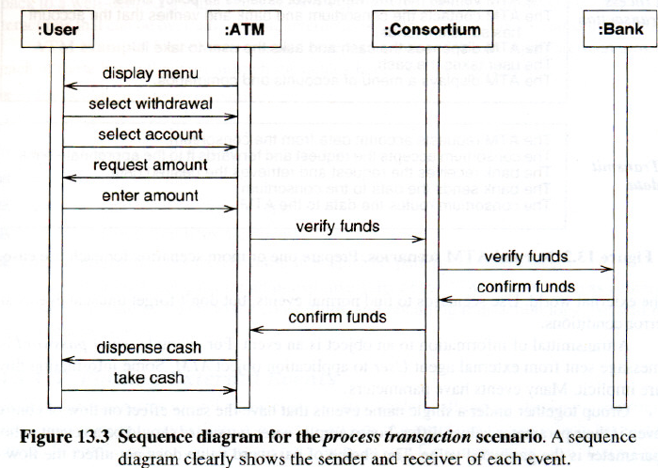

Slide 105
Preparing Activity Diagrams for Complex Use Cases
Sequence diagrams capture the dialog and interplay between actors, but they do not clearly show alternatives and decisions.
E.g. One sequence diagram is needed for the main flow of interaction and additional sequence diagrams are needed for each error and decision point.
Activity diagrams consolidate all this behavior by documenting forks and merges in the control flow

Slide 106
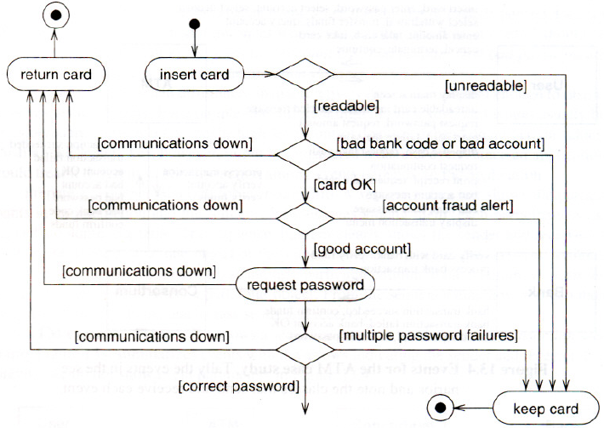
Activity diagram for card verification

Slide 107
Organizing Actors and Use Cases
The next step is to organize use cases with relationships (include, extend, and generalization-Chapter 8). This is especially helpful for large and complex systems

Slide 108
Checking Against the Domain Class Model
At this point, the application and domain models should be mostly consistent.
Application and domain models are cross checked to ensure that there are no inconsistencies.
Scenarios are examined and it is ensured that the domain model has all the necessary data.
Also it is ensured that the domain model covers all event parameters.

Slide 109
Application Class Model
Application classes define the application itself, rather than the real-world objects that the application acts on. [The following points has to be elaborated for task-2]
Steps in constructing application class model:
Specify user interfaces.
Define boundary classes.
Determine controllers.
Check against the interaction model.

Slide 110
Application State Model
The application state model focuses on application classes and augments the domain state model. [The following points has to be elaborated for task-2]
Determine application classes with states.
Find events.
Build state diagrams.
Check against other state diagrams.
Check against the class model.
Check against the interaction model.

